Slide 1
GRAPH AND WEB ANALYTICS - 23DSB3511
CyberGraph:
Intelligent Web Threat Analytics
Nikhitha Vedantam - 2320030075
Nishitha Vedantam - 2320030076
Geetha Ganta - 2320030487

Slide 2
The Problem: Why Web Threat Detection Needs Graph Analytics
2
Web servers generate large numbers of requests, and attacks can look harmless when each IP is examined alone.
Traditional per-IP thresholds can miss coordinated attacks such as a botnet where many IPs share the same target and request pattern.
CyberGraph models relationships between IPs, URLs and user-agents so that coordinated behaviour becomes visible.
High Volume
Coordination
Many requests must be summarized into useful IP-level behaviour.
Many IPs may work together against one target.
Variety
Hidden Links
Traffic includes normal users, crawlers and multiple attack types.
Shared URLs and user-agents reveal relationships.
Core Problem
Detect threats accurately while also identifying relationships that are invisible in isolated IP statistics.
CyberGraph • Graph and Web Analytics

Slide 3
Real-World Relevance & Impact
3
Security Monitoring
Coordinated Attacks
Explainable Detection
Security teams can inspect web-log behaviour at IP, URL and user-agent levels instead of relying only on single-IP thresholds.
The similarity graph groups IPs with near-identical URL-request profiles, helping expose coordinated botnet activity.
Rules use interpretable signals such as payloads, authentication failures, 404 storms, tool fingerprints and graph communities.
What the Project Produces
Practical Extension
• Threat type for each IP
• Risk score and anomaly score
• Targeted URL centrality
• Similarity and bipartite graph visualisations
• HTML report and interactive Streamlit dashboard
The pipeline accepts a CSV with timestamp, IP, method, URL, status and user-agent, with an optional label column for evaluation.
CyberGraph • Graph and Web Analytics

Slide 4
Project Objectives
4
1
Build Graph Structures
Convert web-server logs into IP–URL, IP–User-Agent and IP similarity graphs.
2
Apply Graph Analytics
Use degree, PageRank, HITS, clustering, betweenness and Louvain communities.
3
Detect Threats
Combine Isolation Forest anomaly detection with interpretable graph-aware rules.
4
Validate the Approach
Compare full graph-aware detection with models that remove graph information.

Slide 5
Proposed Methodology & System Architecture
5
01 Load Logs
02 Build Graphs
03 Engineer Features
04 Detect Threats
05 Evaluate
06 Visualise & Report
Logs
Graphs
Synthetic web logs contain timestamp, IP, method, URL, status, user-agent and ground-truth label.
IP–URL bipartite graph, IP–User-Agent graph and IP similarity graph using cosine similarity ≥ 0.90.
Features
Detection
13 behavioural + 9 graph features are computed for every IP.
Isolation Forest + rule score → weighted risk score → predicted attack type.
CyberGraph • Graph and Web Analytics

Slide 6
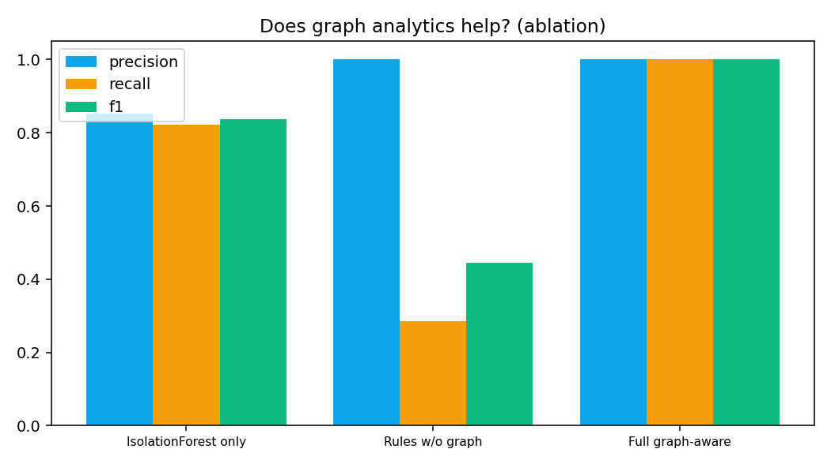
Results & Evaluation
6
8,793
360
3,281
56
1.000
requests
unique IPs
IP–URL edges
malicious IPs
Full-model F1
Model | Precision | Recall | F1
Isolation Forest only | 0.852 | 0.821 | 0.836
Rules without graph | 1.000 | 0.286 | 0.444
Full graph-aware model | 1.000 | 1.000 | 1.000
Key Observation
Without graph features, the DDoS botnet (40 of the 56 attackers) is missed. The graph-aware model identifies the coordinated group in the supplied synthetic dataset.
CyberGraph • Graph and Web Analytics

Slide 7
Technologies Used
7
Programming
Data Handling
Graph Analytics
Python 3.9+
Core implementation and data processing
Pandas / NumPy
Log processing and feature preparation
NetworkX
Graph construction, centrality, communities
Machine Learning
Visualisation
Dashboard
Scikit-learn
Isolation Forest, scaling, evaluation metrics
Matplotlib
Graphs, confusion matrix, ablation and timelines
Streamlit
Interactive tabs, filters, upload and drill-down
Input
Synthetic web logs by default; the application can also accept a user-provided CSV with the required log columns.
CyberGraph • Graph and Web Analytics

Slide 8
Project Timeline & Development Stages
8
1
Data generation / loading
Create or load web logs with ground-truth labels.
2
Graph construction
Build IP–URL, IP–User-Agent and similarity graphs.
3
Feature engineering
Calculate behavioural and graph features.
4
Threat detection
Run Isolation Forest and graph-aware rules.
5
Evaluation
Calculate precision, recall, F1 and confusion matrix; run ablation.
6
Outputs
Generate visualisations, CSV files, HTML report and Streamlit dashboard.

Slide 9
Conclusion
9
Scalable
Graph-Aware
Explainable
The graph pipeline converts web logs into multiple graph views and IP-level features that can be reused on larger log collections.
Community size and similarity relationships help expose coordinated DDoS activity that isolated IP rules can miss.
Attack types are assigned with transparent rules, while the hybrid risk score combines anomaly and rule evidence.
Important Limitation
The supplied project uses synthetic data, and its rule thresholds were tuned on that data. The perfect 1.000 full-model scores therefore should not be treated as expected real-world performance.
Future Work
Temporal/dynamic graphs, Graph Neural Networks such as GraphSAGE, real web-log datasets, and streaming detection.
CyberGraph • Graph and Web Analytics

Slide 10
THANK YOU

